Slide 1

Automated Vacuum Cleaner
Presented by: Joshua O’Dell, Rudra Sharma

Slide 2
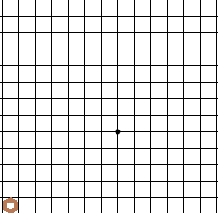
Project strategy/goal
Simulate a room in a 2D grid
Points on the grid represents the points in the room
Test a variety strategies for path finding strategies for the vacuum robot
Compare the performance of the strategies in terms of their success rate

Slide 3
Project Implementation
Ported a python codebase of basic vacuum robot into Java
Added a library [lanterna] and implemented its API to visualize the robot movements on a 2D grid
Implemented various forms of robots
Developed a test matrix to run the clean simulations and compute averages

Slide 4
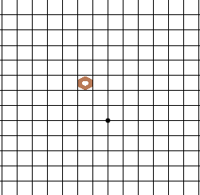
Basic Bots
Random Robot - Randomly chooses next adjacent location on the grid and moves to that point
Store Map Bot - Randomly chooses next location on the grid, however it knows about its room borders, uses simple heuristic to determine a border point

Slide 5
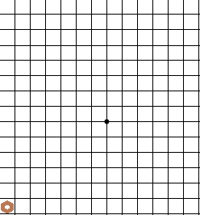
Store Map & Maintain Direction Bot
Knows the borders of the room
Heuristic to strategize the direction travels
Only travels North, South, East, West (not north-west, south-west …)
When it hits a border it slides to an adjacent box and moves in the opposite direction

Slide 6
Store Explored Robot
Holds all the points the bot has explored
Uses heuristic to give priority on its neighboring nodes
TODO:Explain priority heuristic

Slide 7
Proximity Robot
Contains a proximity sensor to detect how close it is to the edge
TODO: Explain proximity sensor heuristic

Slide 8
Hybrid bots
Proximity sensor an store explored Robot
Store Maps and Store Explored
Some hybrids are better at complementing each other then other (store explored and proximity)
Some don’t perform as well integreged(store maps and explored)

Slide 9
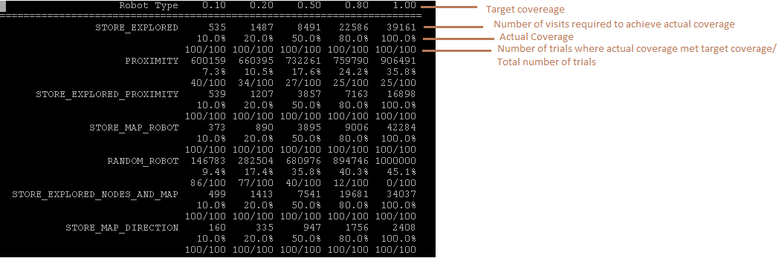
Performance

Slide 10
Future areas for improvement
Elimite low-performing strategies
Refine high-performing algorithms
Add more obstacles to our environment
Add live/in-motion obstacles to the room

